Slide 1
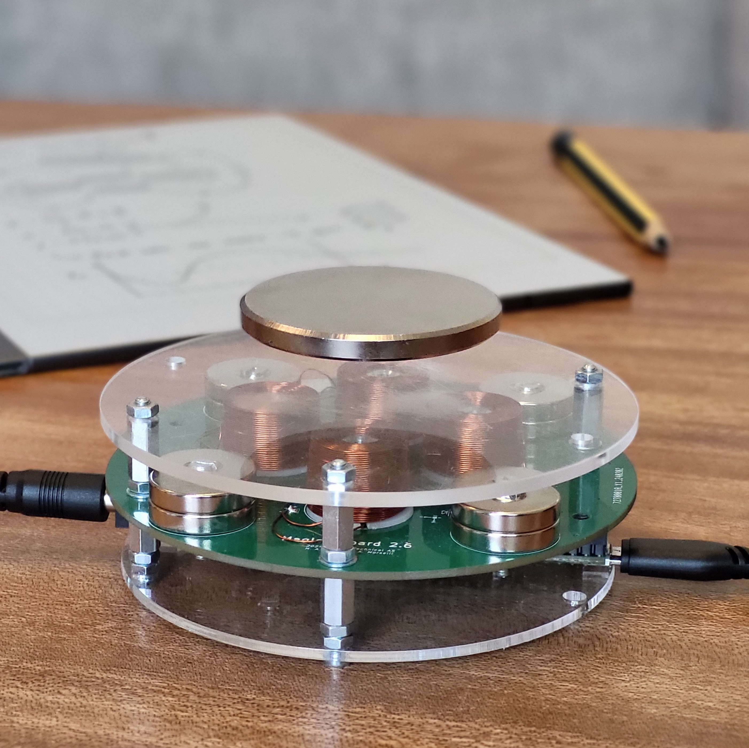
Take-Home Maglev Labs to Promote Self-Efficacy
M2024-03: Excited Mini Project Spring 2024
Hans Alvar Engmark
Excited Seminar - 24.01.2025

Slide 2
Table of contents
Who are we?
Background & Motivation
Overview of the Excited project
Maglev lab hardware developments
Planned lab execution
Result
How did it go?
What about the future?

Slide 3
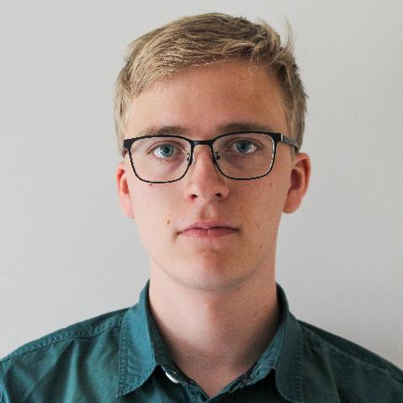
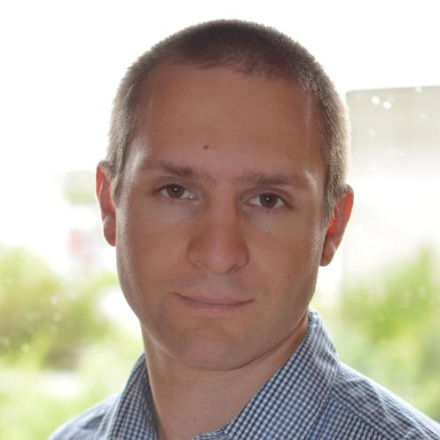
Who are we?
Hans Alvar Engmark
PhD student at ITK, NTNU
Research on data-driven control
Involved in teaching activities
Morten Dinhoff Pedersen
Associated Professor at ITK
Teaching courses on control
Contributor to the development of the teaching program at ITK

Slide 4
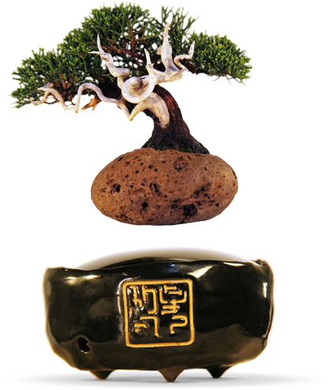
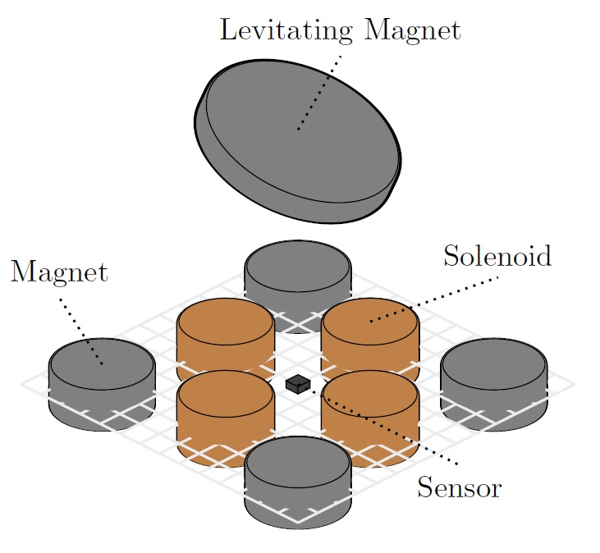
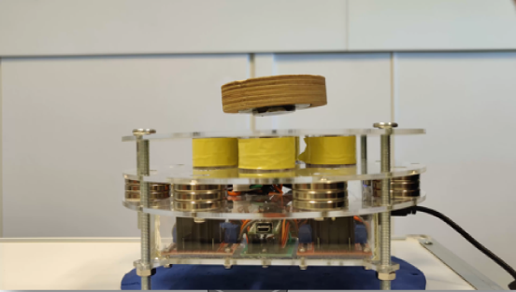
Background & Motivation
Idea: Magnetic levitation as a gateway to advanced technology
Bachelor’s project spring 2022
Task: Make a digital levitation device
Discussions about lab space at ITK
About 50% of courses rely on physical labs
Expensive, old, and too little space
No «Engineering ladder» at ITK
A lack of ownership for students
Remote learning made commonplace
Why not make a «Take-Home lab»?

Slide 5
What is a «Take-home lab»?
«A lab that is low-cost, portable, and that can be used anywhere»
Not a new concept!
Benefits
Flexibility and accessibility
Cost-effective and scalable
Promotes creativity and problem solving
Challenges
Plug-and-play hardware
Not as capable as full lab setups
More reliant on proper lab material
J. A. Rossiter, et al., "Evaluation and demonstration of take-home laboratory kit," IFAC-PapersOnLine, vol. 52, no. 9, pp. 56-61, 2019. https://doi.org/10.1016/j.ifacol.2019.08.124
J. A. Rossiter, et al., "Control education for societal-scale challenges: A community roadmap," Annual Reviews in Control, vol. 55, pp. 1-17, 2023. https://doi.org/10.1016/j.arcontrol.2023.03.007
D. Sotelo, "Lab-Tec@Home: A cost-effective kit for online control engineering education," Electronics, vol. 11, no. 6, p. 907, 2022. https://doi.org/10.3390/electronics11060907

Slide 6
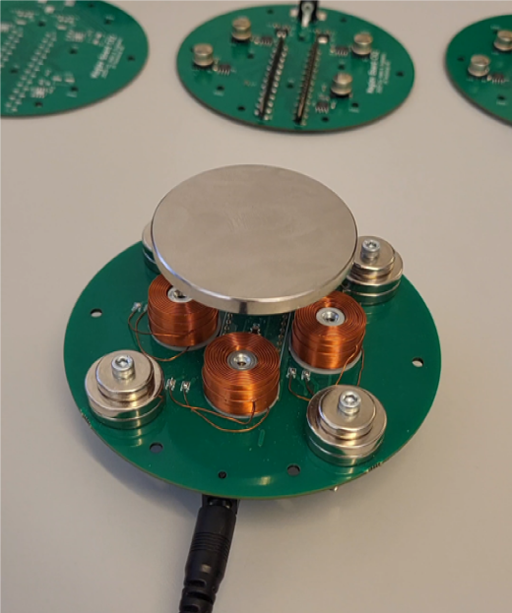
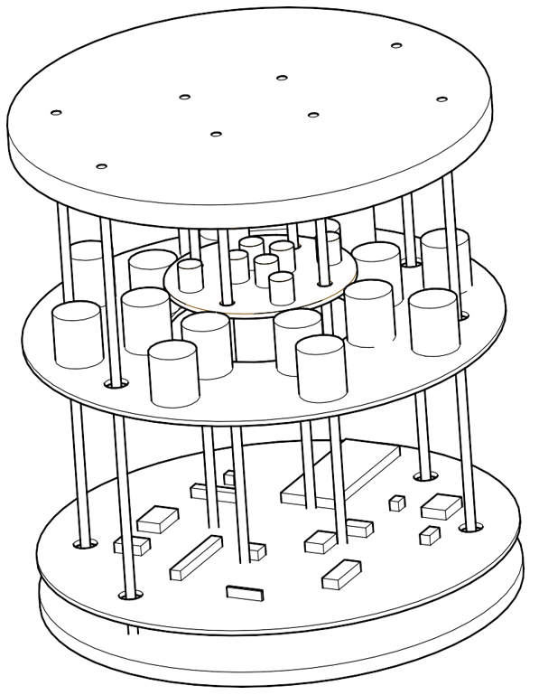
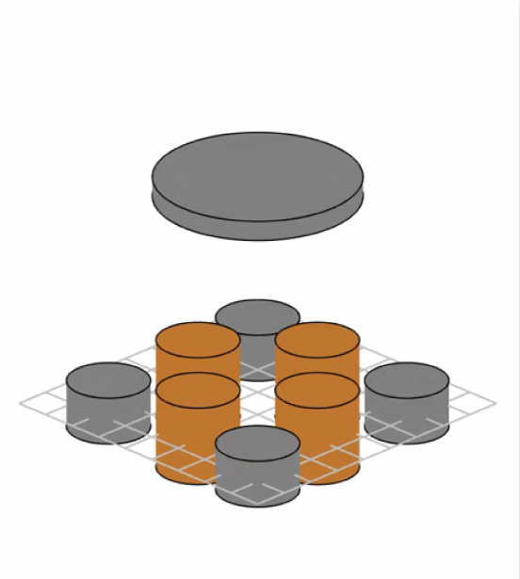
Take-Home Maglev Labs to Promote Self-Efficacy
NTNU
Topic
Development and assessment of a new type of personal lab for engineering students
Team
ITK Trondheim
Hans Alvar Engmark
Morten Dinhoff Pedersen
3 MSc students
ITK Ålesund
Robin T. Bye et al.
External
Alberto Morselli, UNIPD, Padova, Italy
Implementation roadmap
January – June: Design and build a system, produce learning material
and deploy simple levitation control algorithms
June - July: Design our assessment method
(surveys, behavioral observation, interviews, etc.)
August: Execute a 2-day mini-course for students at IE
Aug. – Sept.: Analyze and disseminate results
Outcomes
Working system & teaching material
Workshop & dissemination report
Papers (Planned for IBCE24, others to be decided)
Expected impact
Assess its usefulness as a tool for improving self-efficacy among students
Adoption for use in ITK and other departments, and other universities
Pave the way for more labs built on the same principle
V2.0 with digital controller
Illustration of V3.0, courtesy Alberto Morselli
Simulation with perturbation

Slide 7
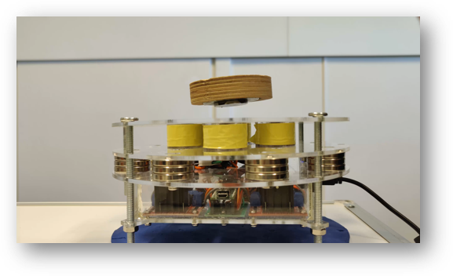
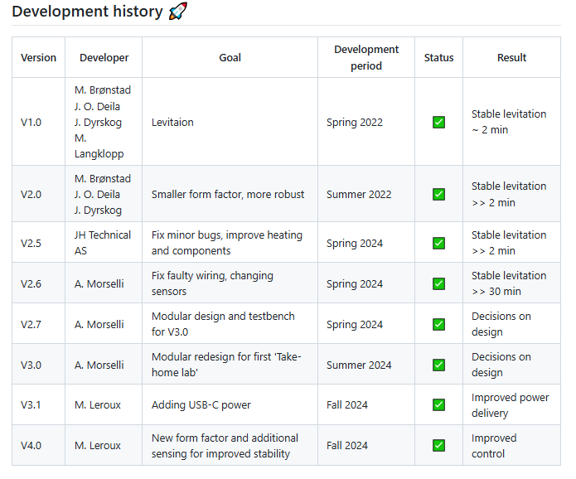
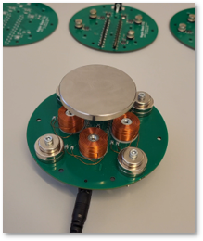

Development History
NTNU

Slide 8
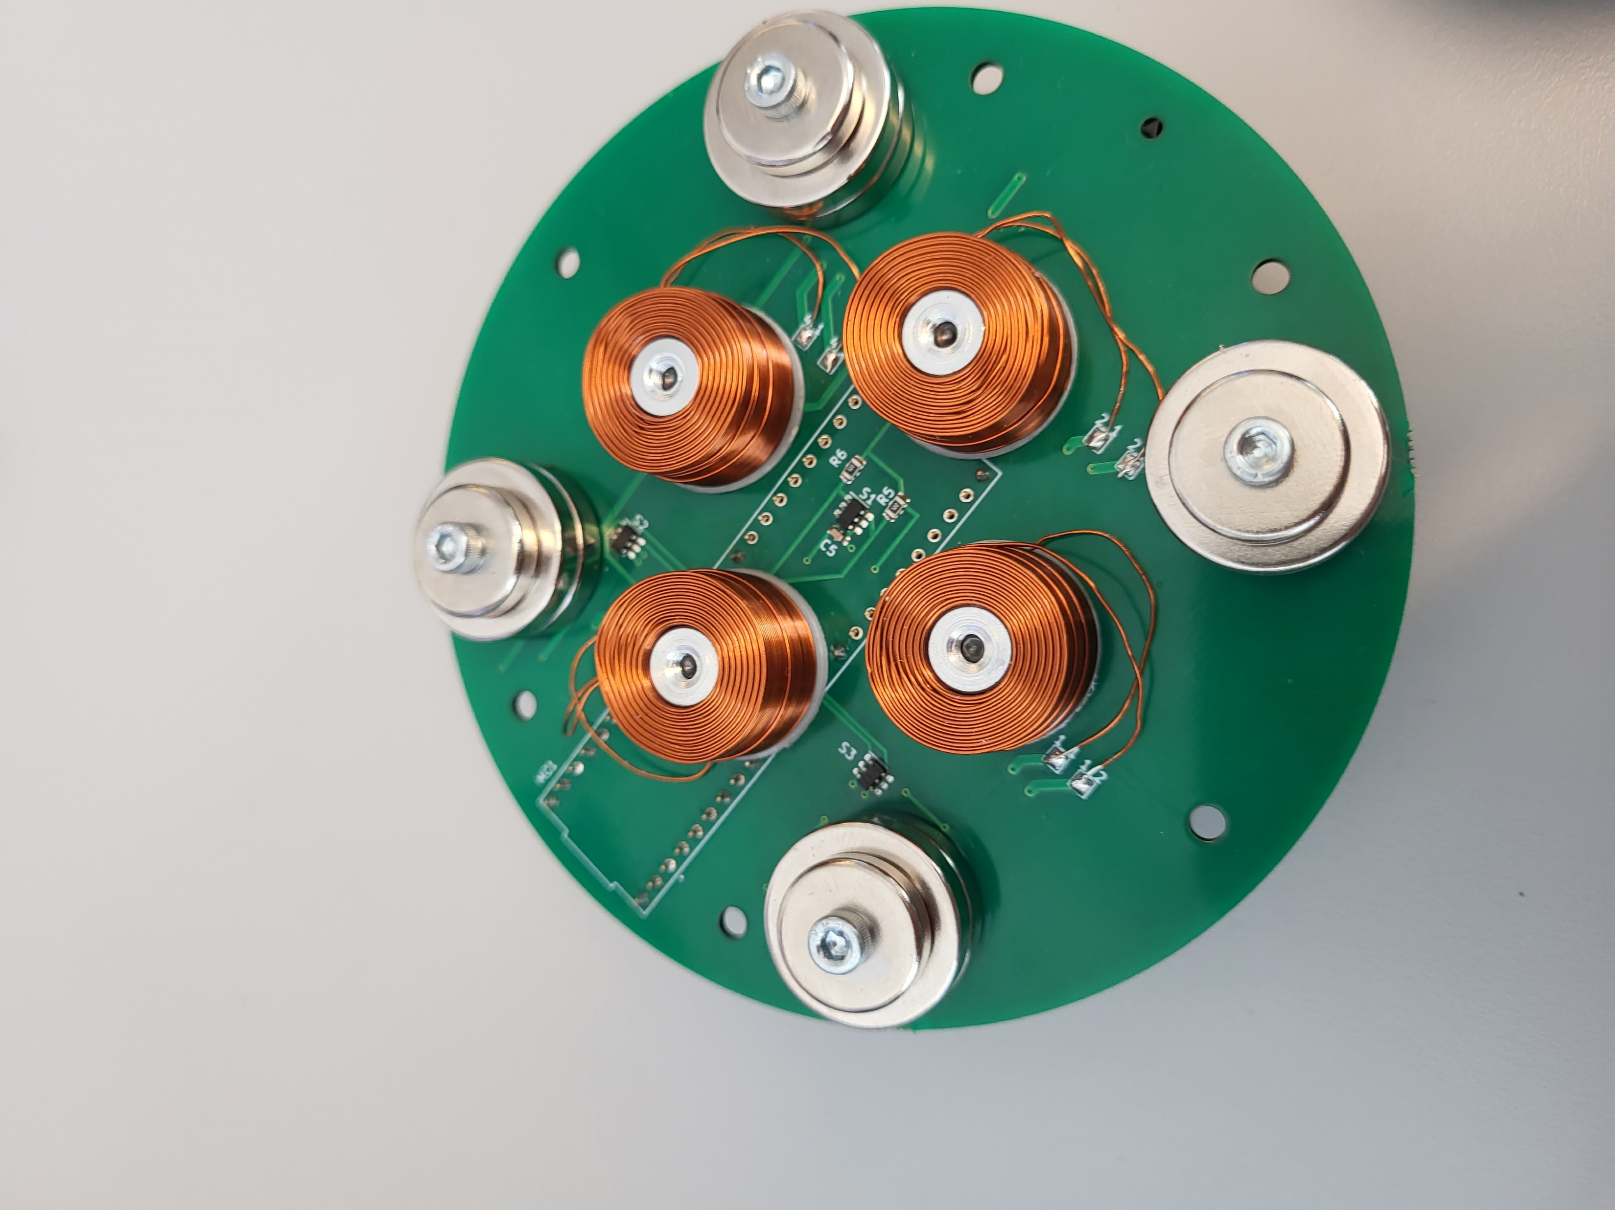
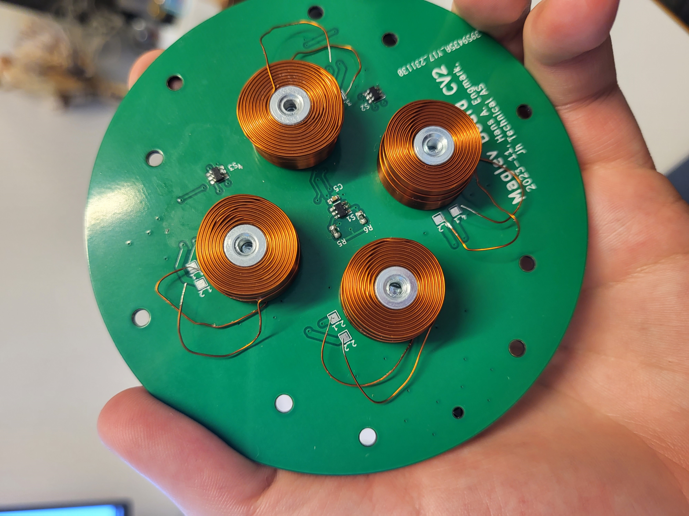
Hardware Development
NTNU
V2.0
V2.5

Slide 9
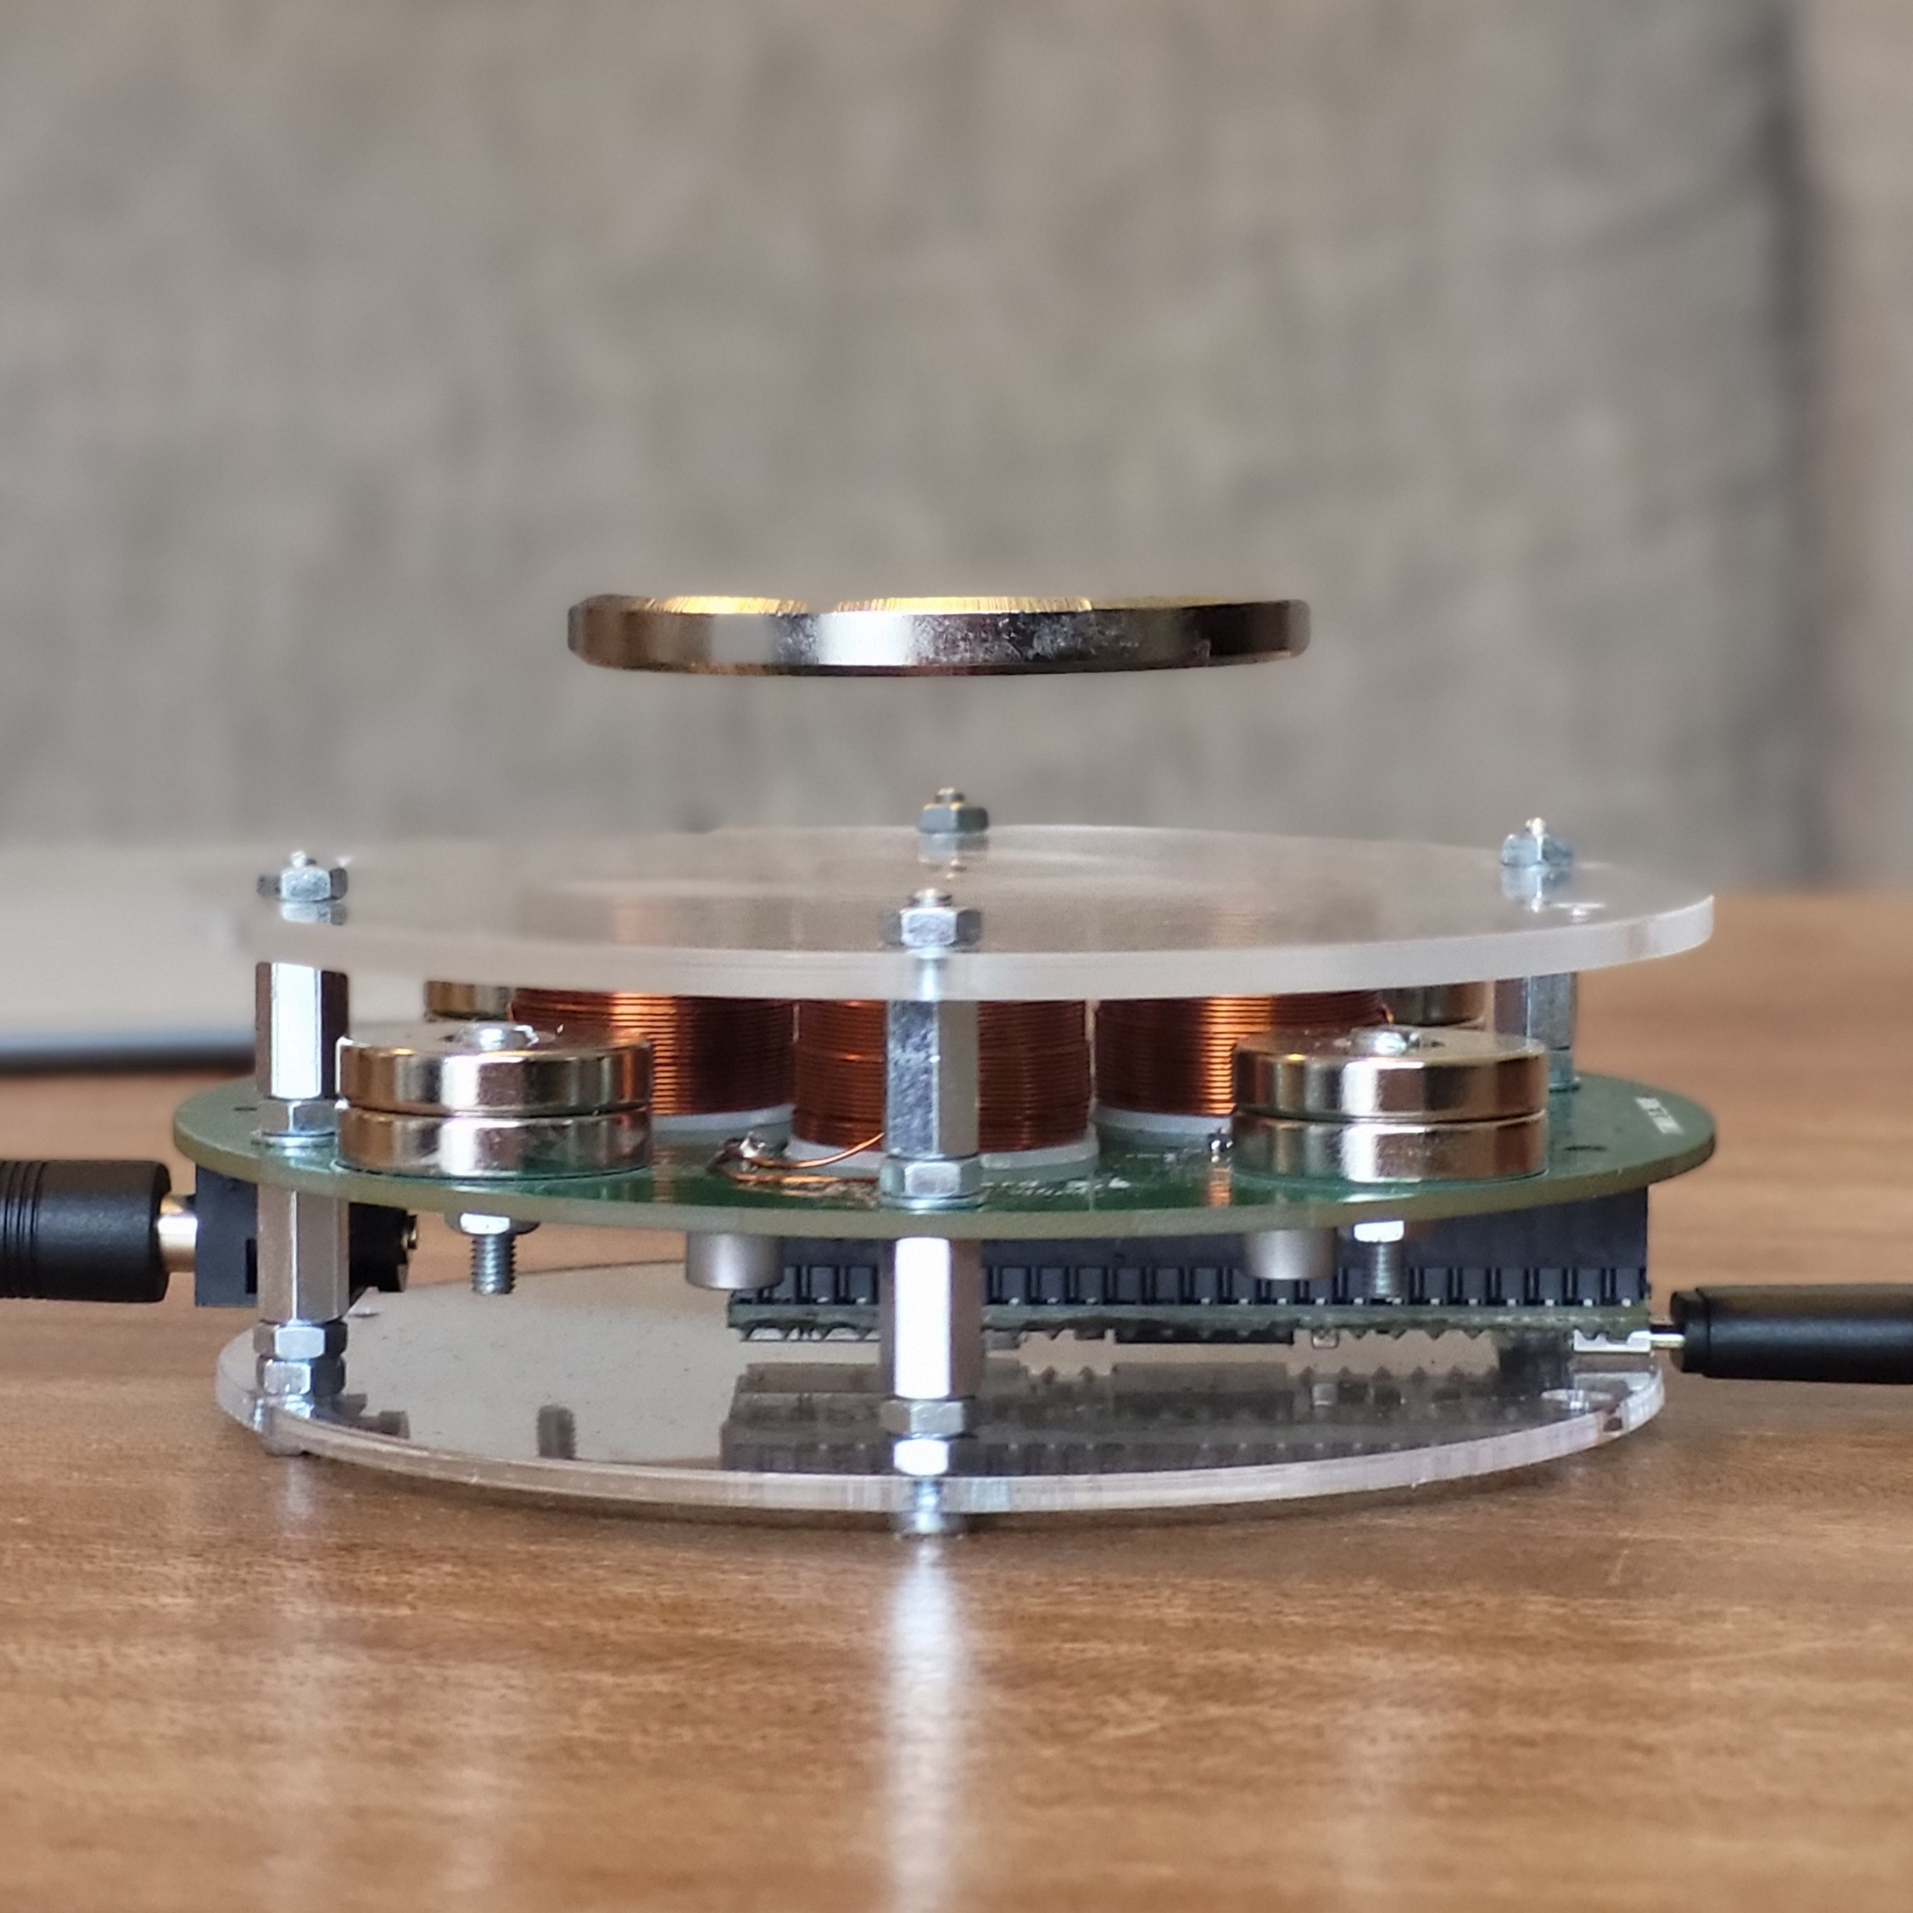
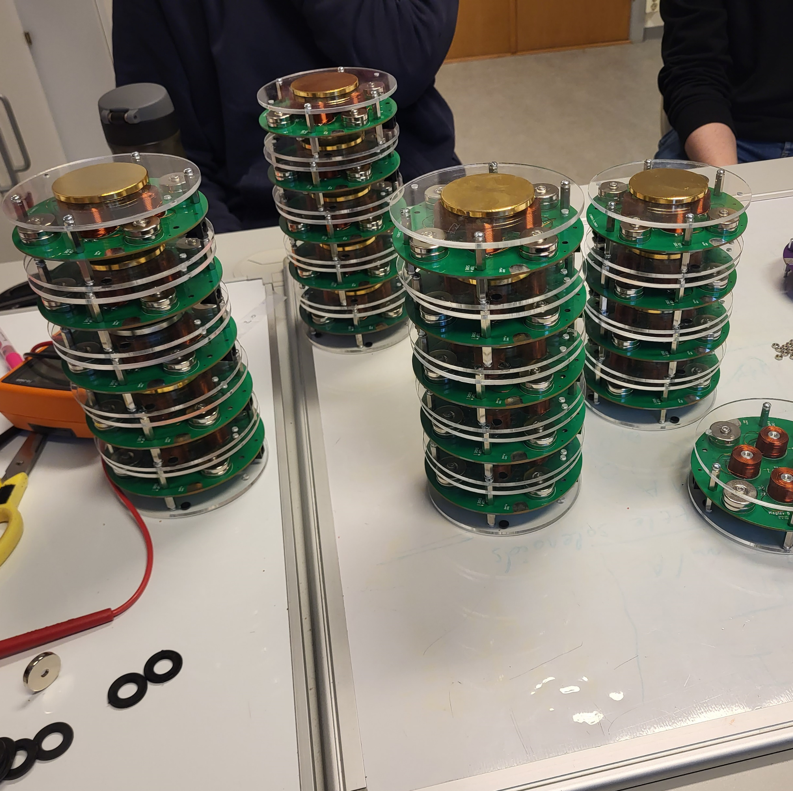
Hardware Development
NTNU

Slide 10
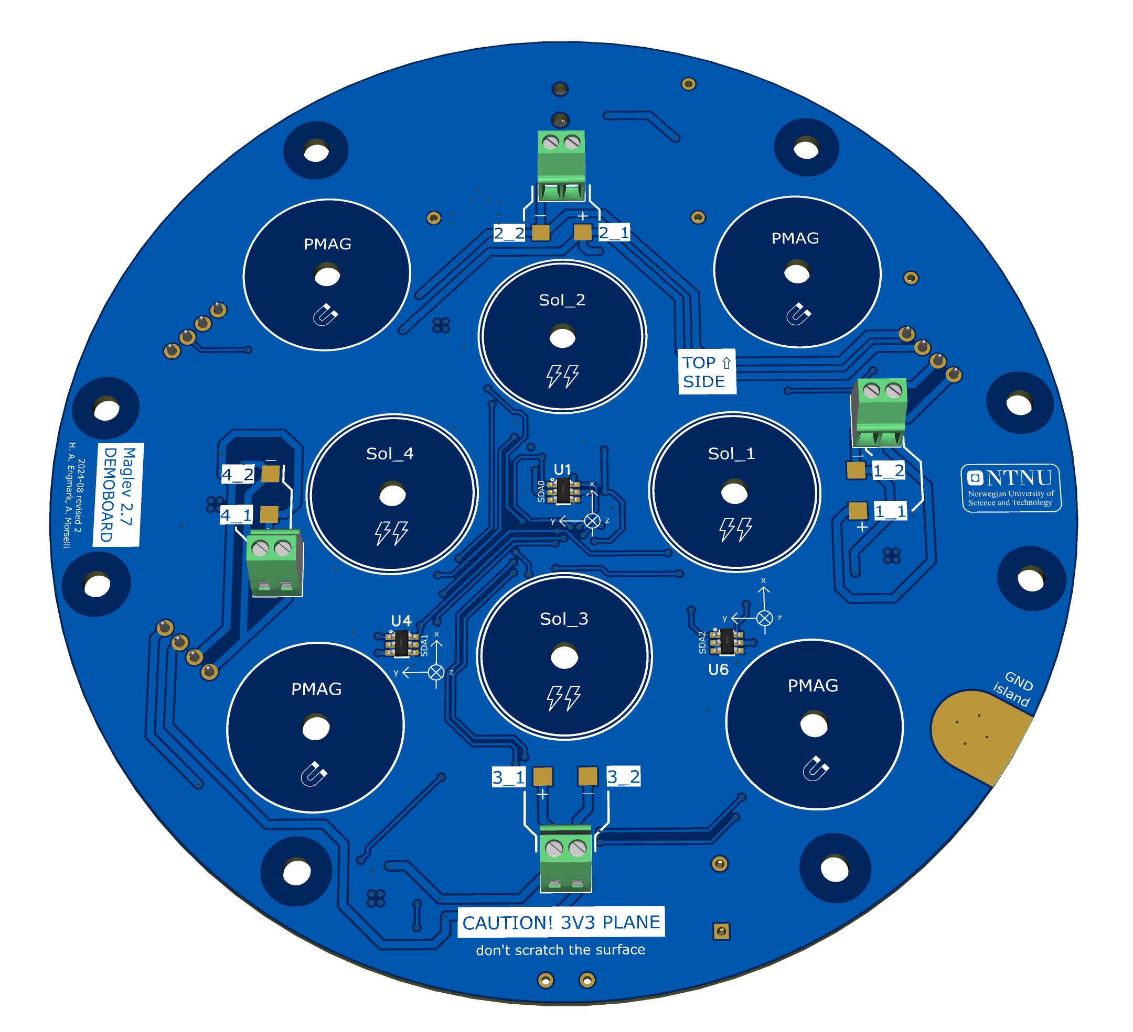
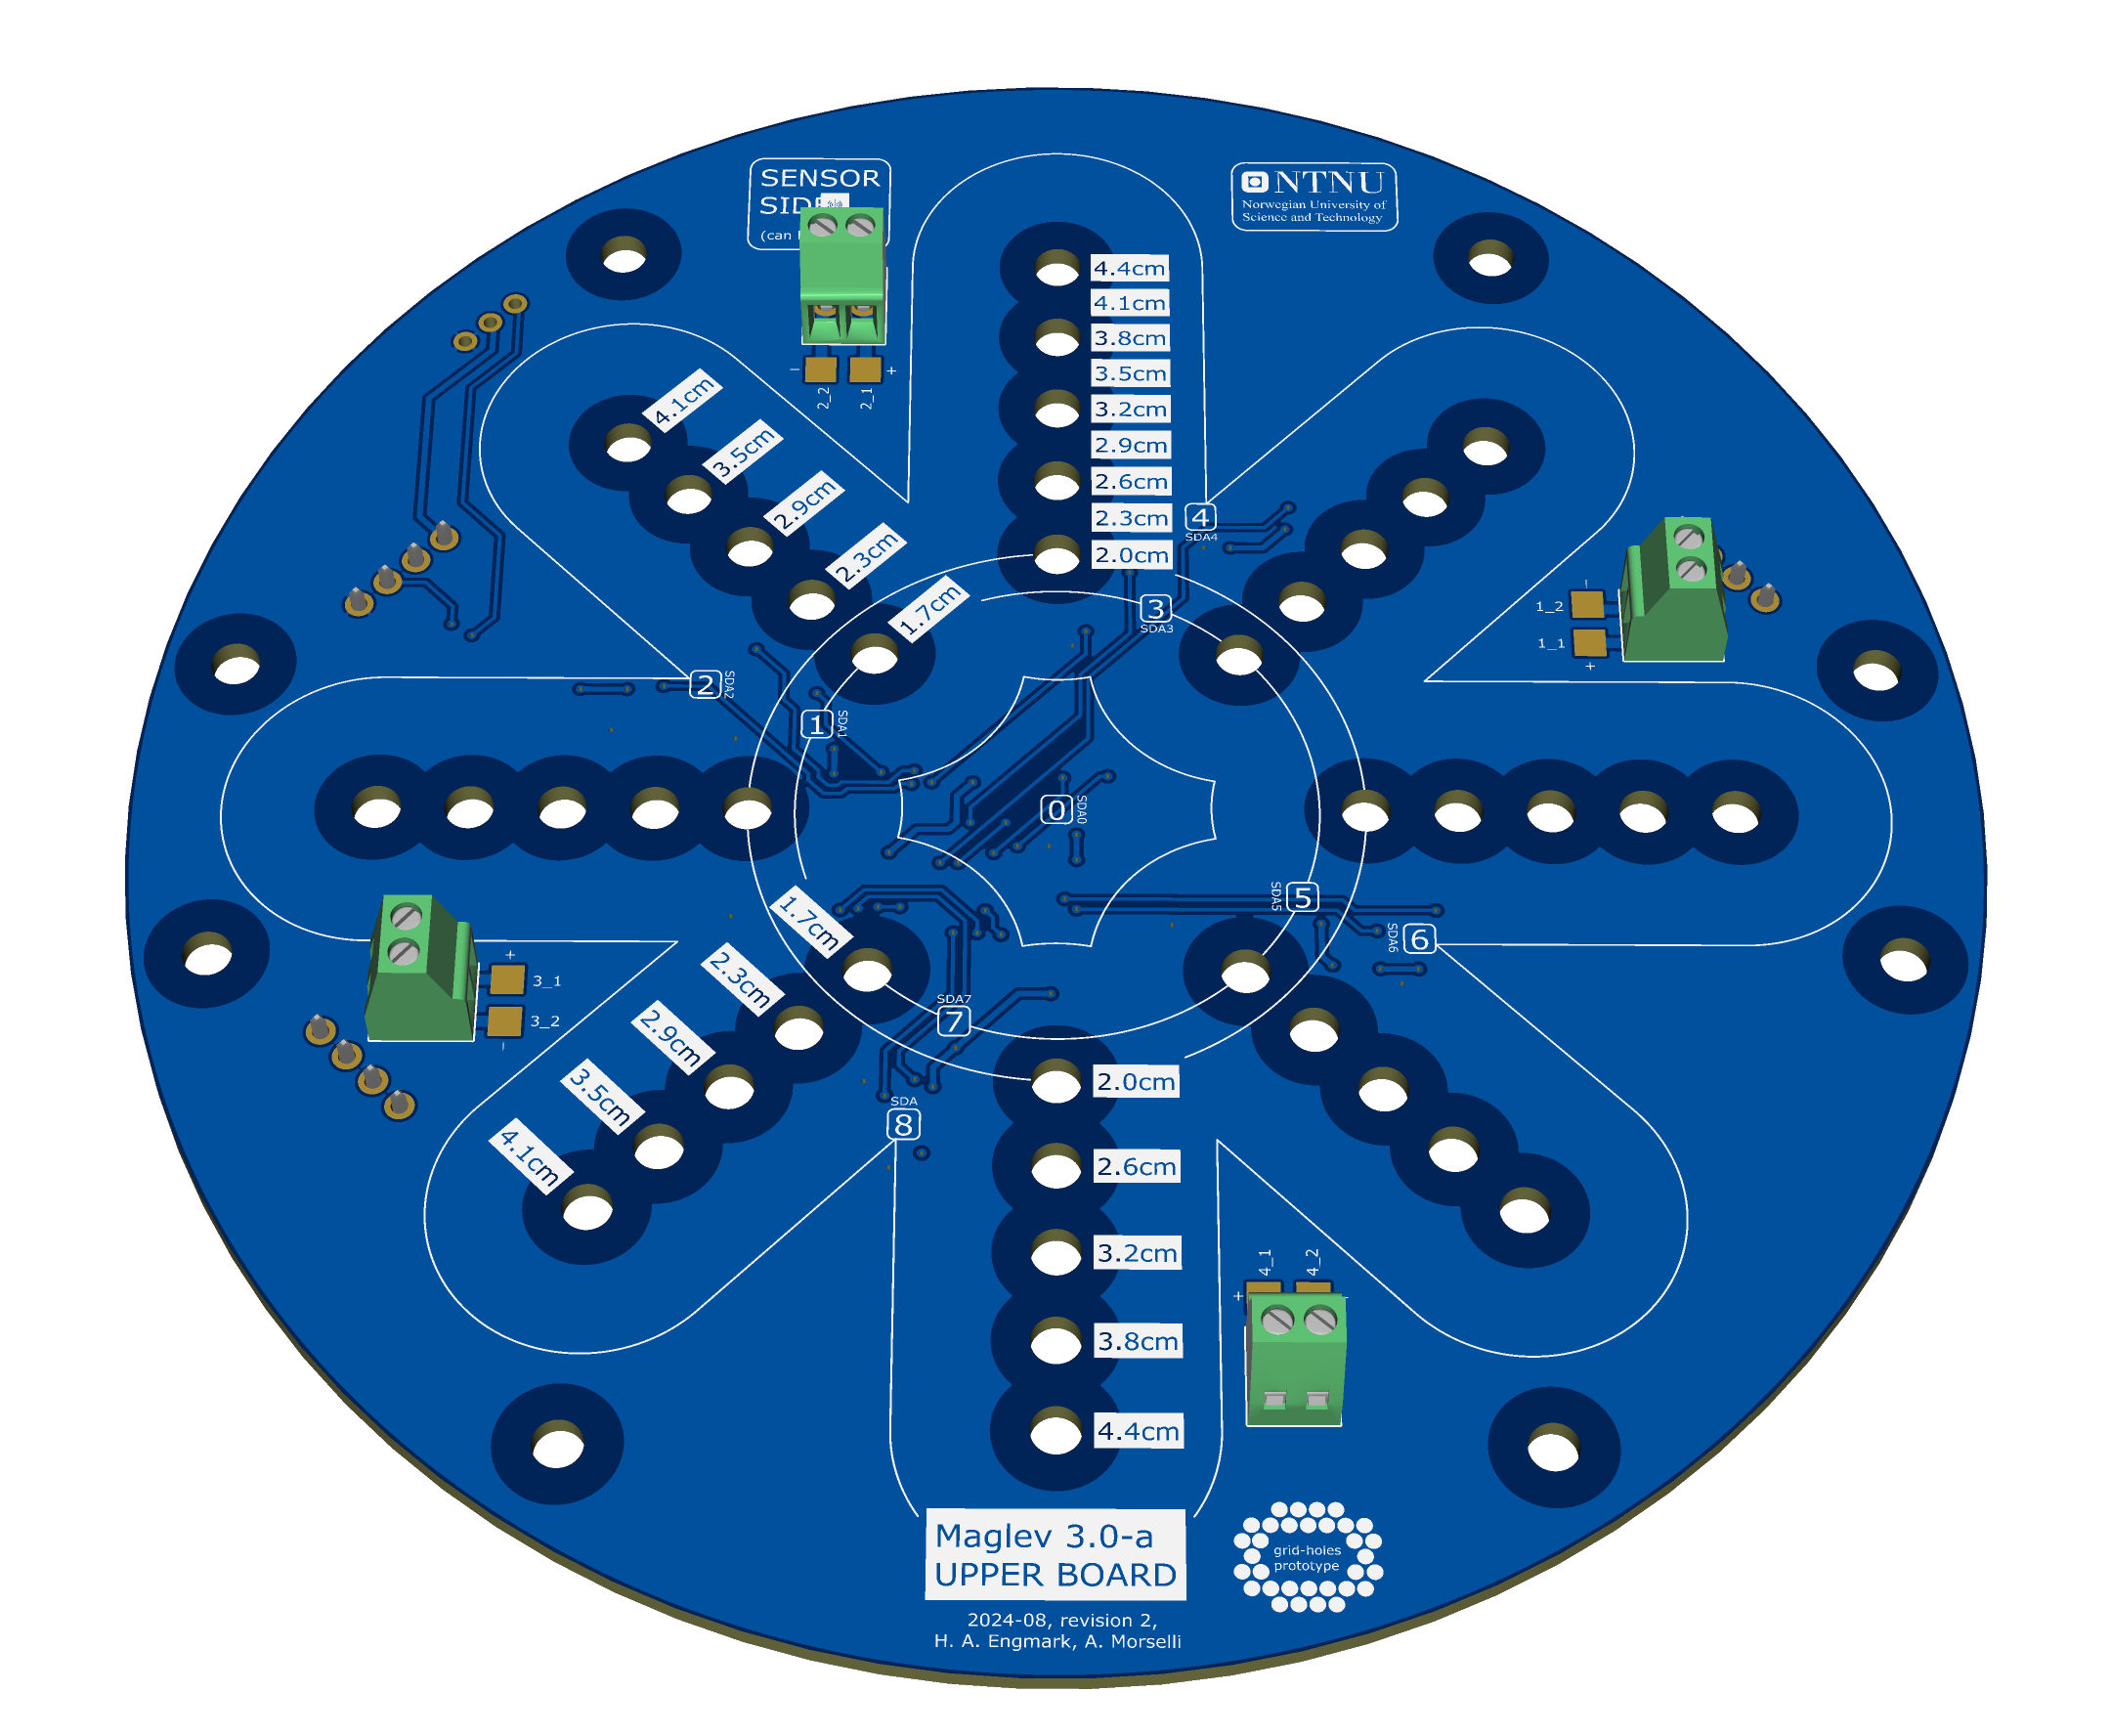
Hardware Development
NTNU

Slide 11
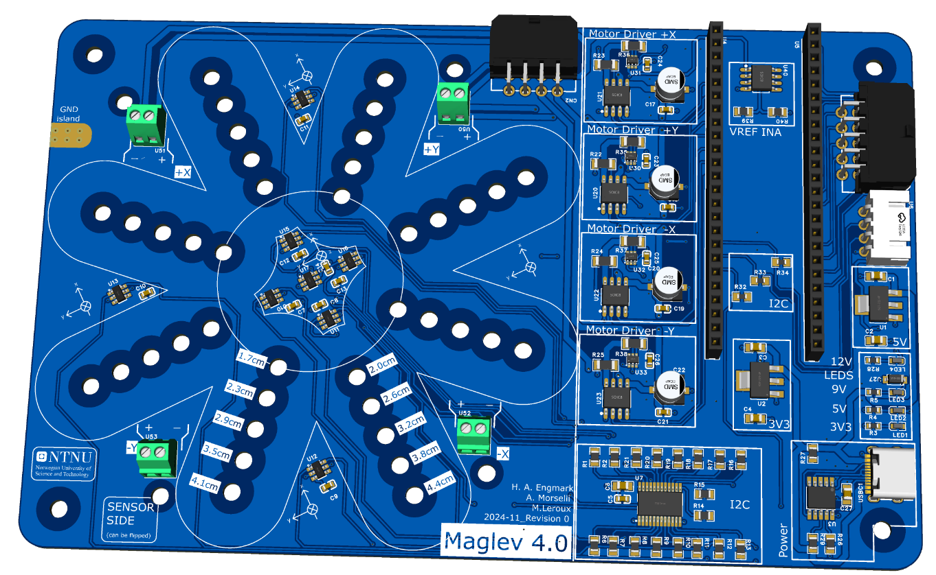
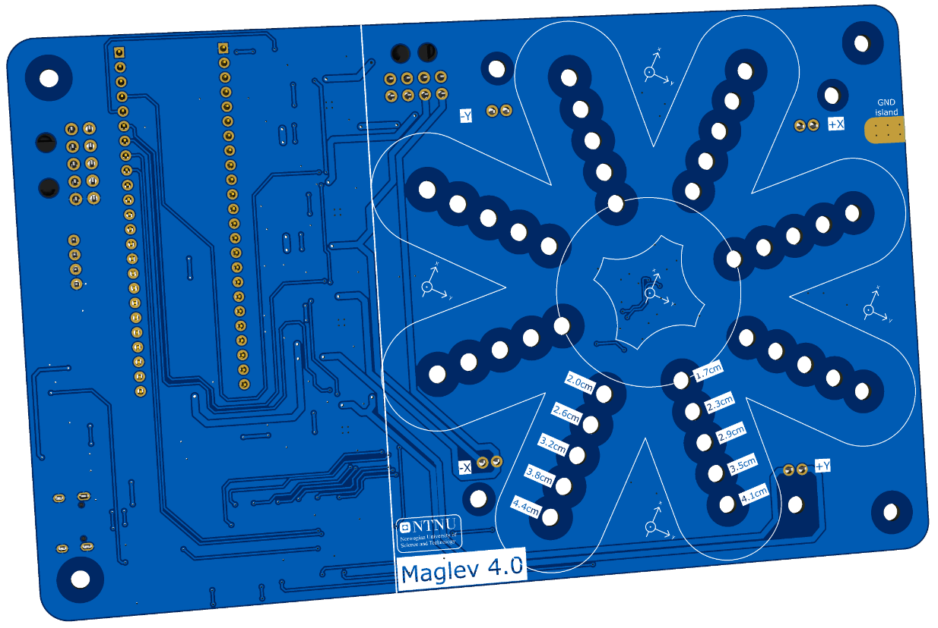
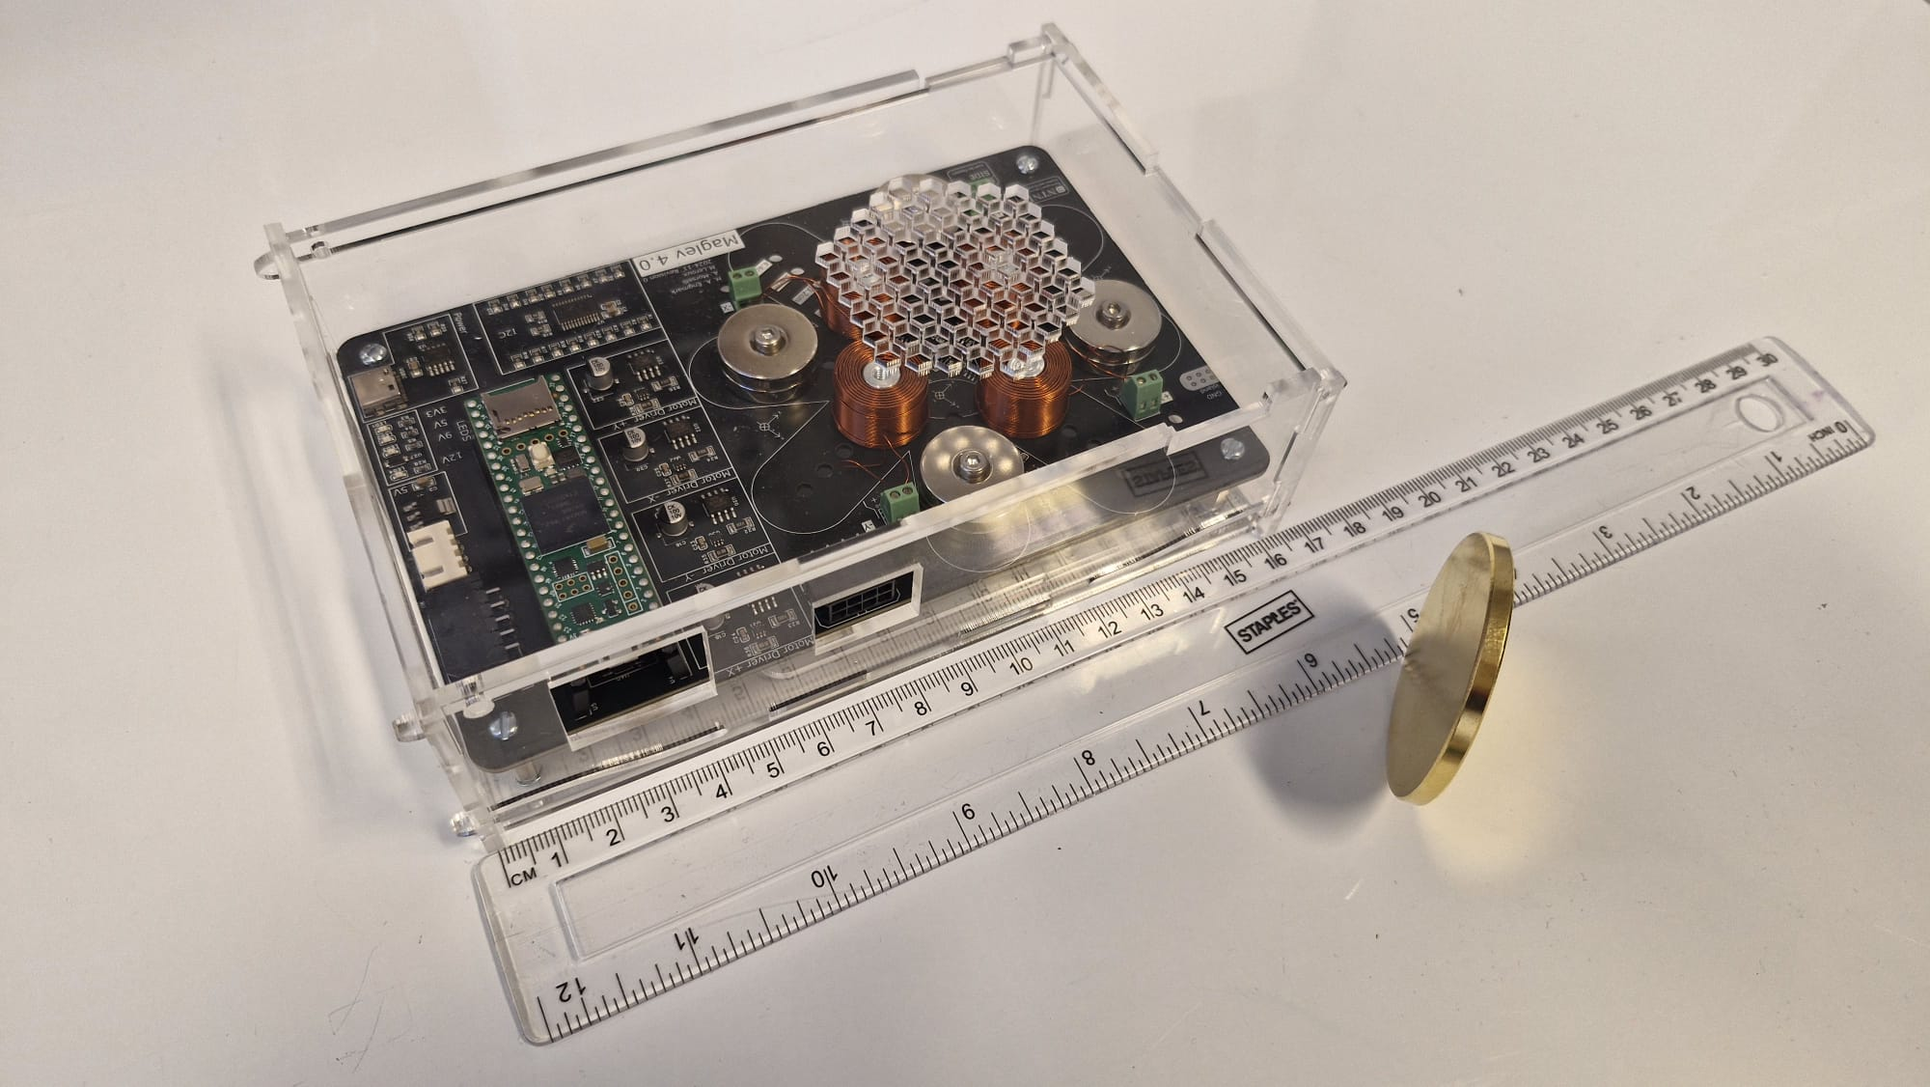
Hardware Development
NTNU

Slide 12
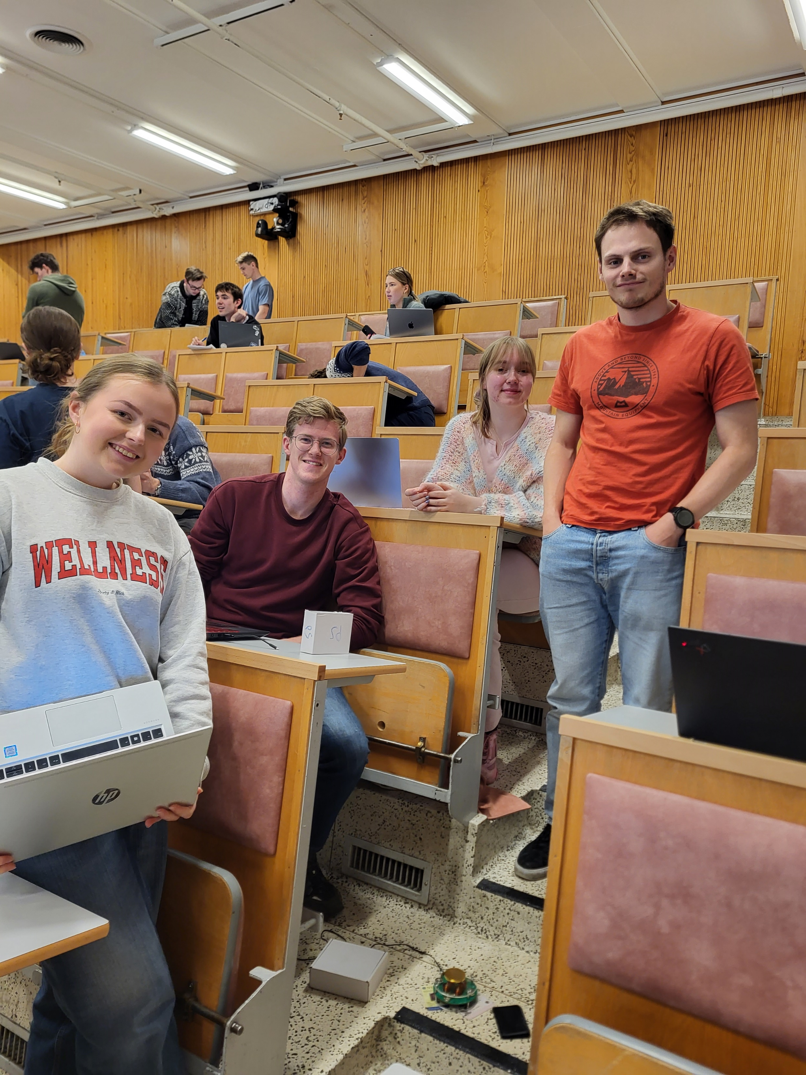
Teaching Material & Pilot Lab in TTK4111
NTNU
Teaching material made in August
One «virtual lab» and one «physical lab»
2 sessions over two weeks ~3 hours each
Groups of 4 students
Pilot lab start: 23.09.24 11.11.24
Made optional for students (bias in data?)
Made simpler, by request (exam period)
A/B study over two weeks
Group A: started with simulated lab
Group B: started with physical lab
Switch in the second week
Questionnaire after each session
Focusing on efficacy
Group reflection note

Slide 13
Results from labs
NTNU
«The physical lab could have gone much more in-depth, for example by writing the code from scratch ourselves, more like a project assignment»
About 80 out of 200 students
Lower significance on questionnaires
The virtual and physical labs were not so well connected
The simulator and physical systems are not «one-to-one»
Initial feedback is positive, and students report confidence
But biased by selection of students and simplification of the learning material
«The virtual lab was probably more instructive, but the pracitcal lab was definitely the most fun!»
«We would have liked to have the lab earlier in the semester so that we could actually allocate time for it»
«All-in-all an interesting and cool lab»

Slide 14
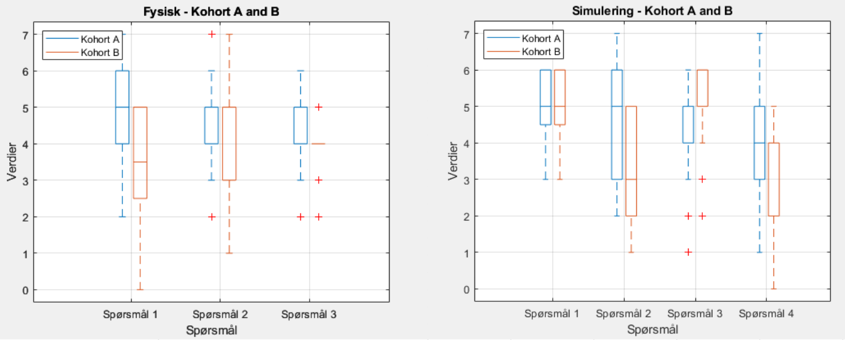
Results from labs
NTNU
Key question: Is it worth putting resources on a physical lab?

Slide 15
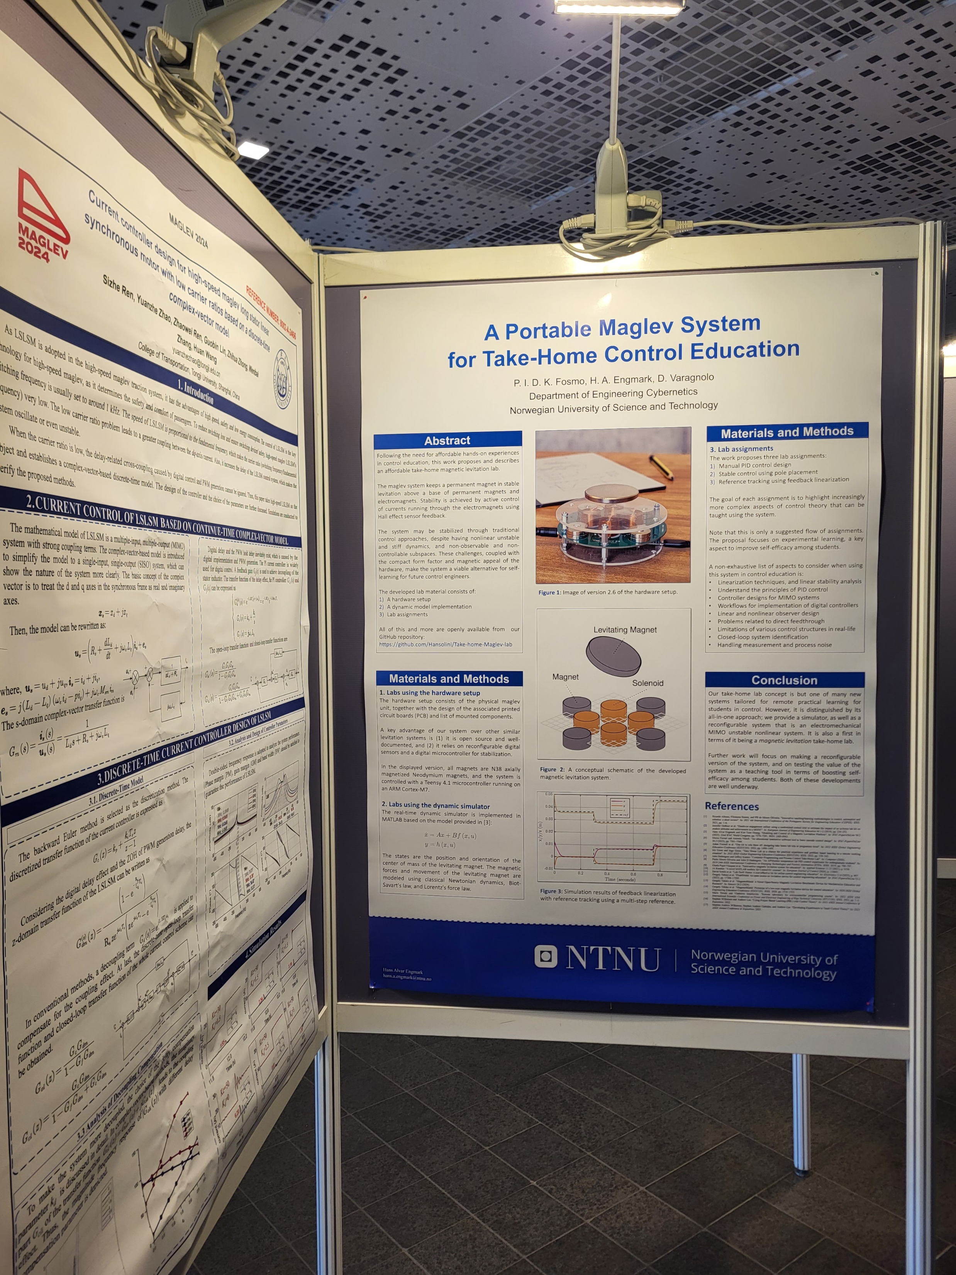
Dissemination of Results
NTNU
Paper and poster at Maglev24
New contacts, and a unit sent to Germany
Presentation internally at ITK
With plans for implementation in at least three courses
Report with results ~ March?
Unfortunately, less substantial results than desired – but we learned a lot!

Slide 16
What did we learn?
Students like physical labs, but virtual labs have their place
Students are excited to adopt new teaching methods
Educational science requires dedicated educational expertise
AB studies require a solid plan and a first-rate execution

Slide 17

What about the plan?
Implementation roadmap
January – June: Design and build a system, produce learning material
and deploy simple levitation control algorithms
June - July: Design our assessment method
(surveys, behavioral observation, interviews, etc.)
August: Execute a 2-day mini-course for students at IE
Aug. – Sept.: Analyze and disseminate results
Outcomes
Working system & teaching material
Workshop & dissemination report
Papers (Planned for IBCE24, others to be decided)
Expected impact
Assess its usefulness as a tool for improving self-efficacy among students
Adoption for use in ITK and other departments, and other universities
Pave the way for more labs built on the same principle
Only a survey
Moved to November
Moved to 2025
Need better connection from sim to real
Still lacking a proper report
Results are promising, but not conclusive

Slide 18
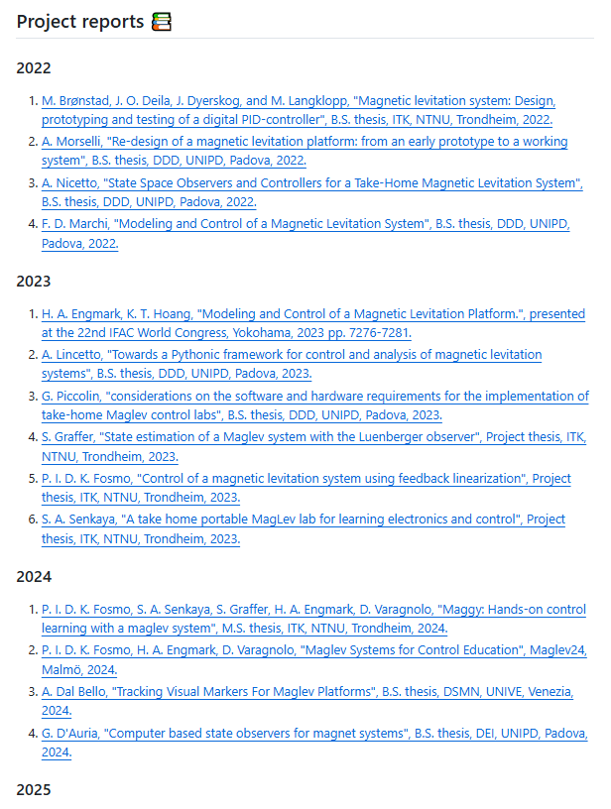
What’s next?
Spring 2025
2 master’s students: physical implementation of advanced control
2 bachelor’s students: Integrate a camera solution for more flexibility in labs
1 internt: Development of computer interface and alignment of sim to real
Excited project on «smart books»
Feasibility study from students in Poland
IFAC support for international collaboration
Lab in control course at NTNU, Ålesund
Fall 2025
Integration into two courses at ITK
More master’s students
Startup of «MicroLabs@ITK»?
?

Slide 19
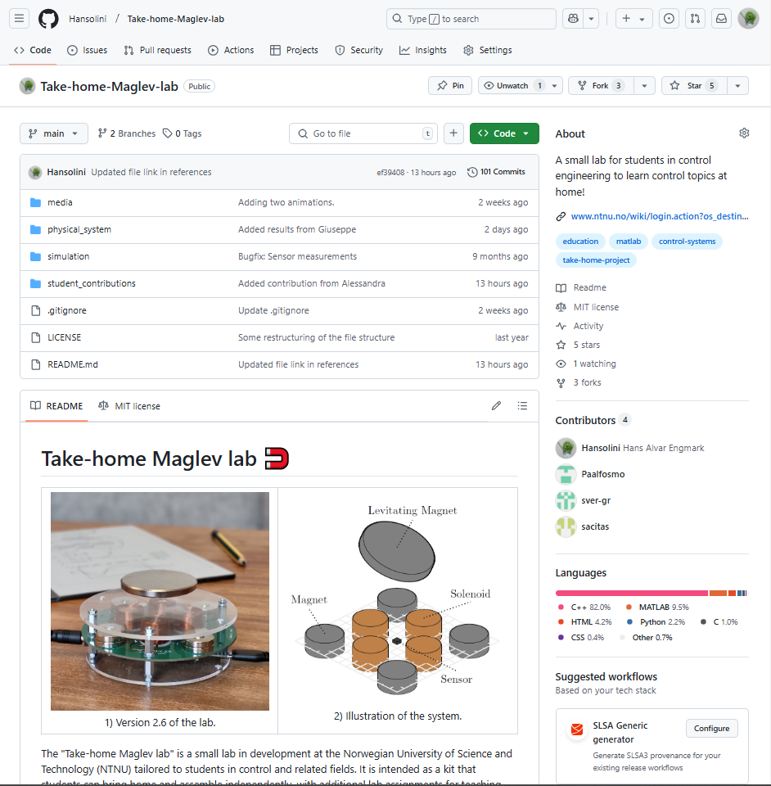
Want more information?
Visit our GitHub repository for...
Blueprints
Firmware
Software
Images & Videos
Student Reports

Slide 20
Thank you!
Questions?

